Slide 1
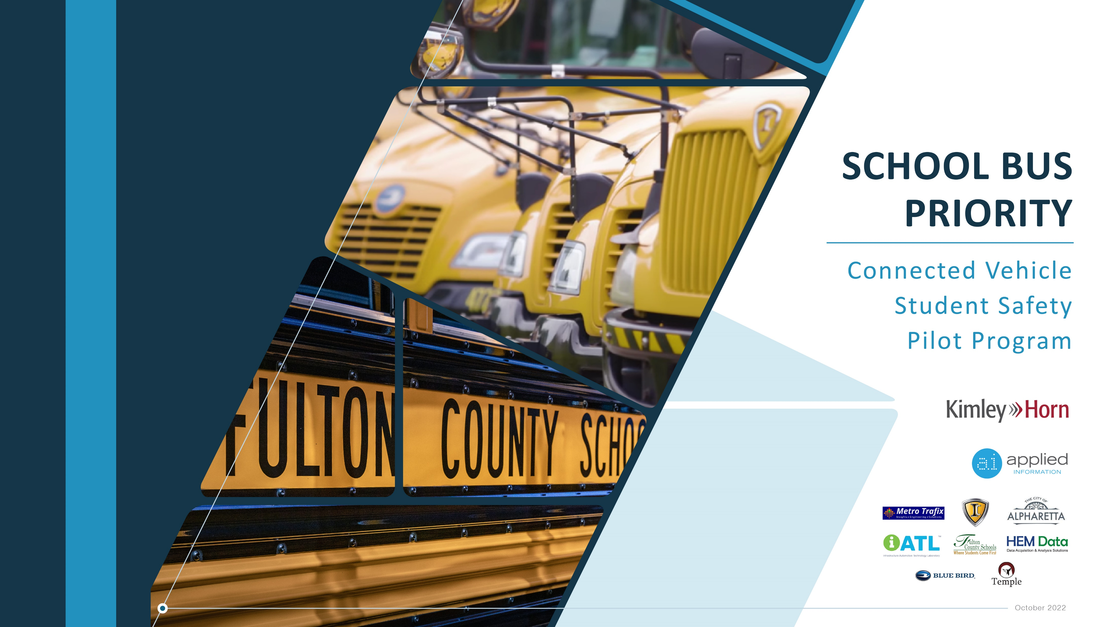



Slide 2
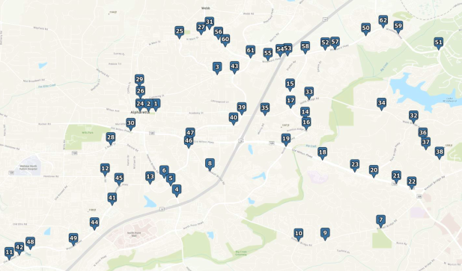
Project Background
Onboard units (OBUs) installed on two FCSS school buses:
  IC Bus (diesel)
  Blue Bird (propane)
Field monitoring units (FMUs) installed at 62 signalized intersections
Pick-up and drop-off at:
  Manning Oaks Elementary School
  Webb Bridge Middle School
  Alpharetta High School
Project Intersections

Slide 3

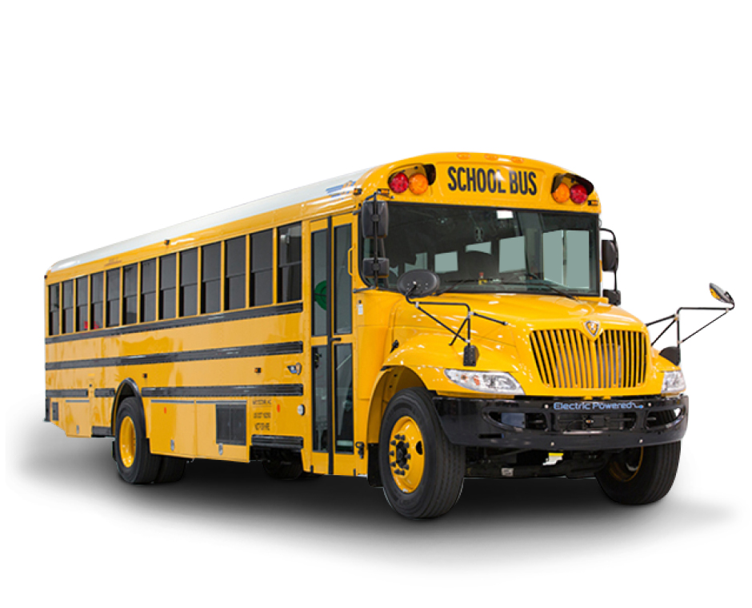
School Bus Priority Solution
When within range of signalized intersection, priority service is requested for the school bus:
Green phase extension
Safety truncate opposing green phase and transition to serve school bus
Software

Slide 4
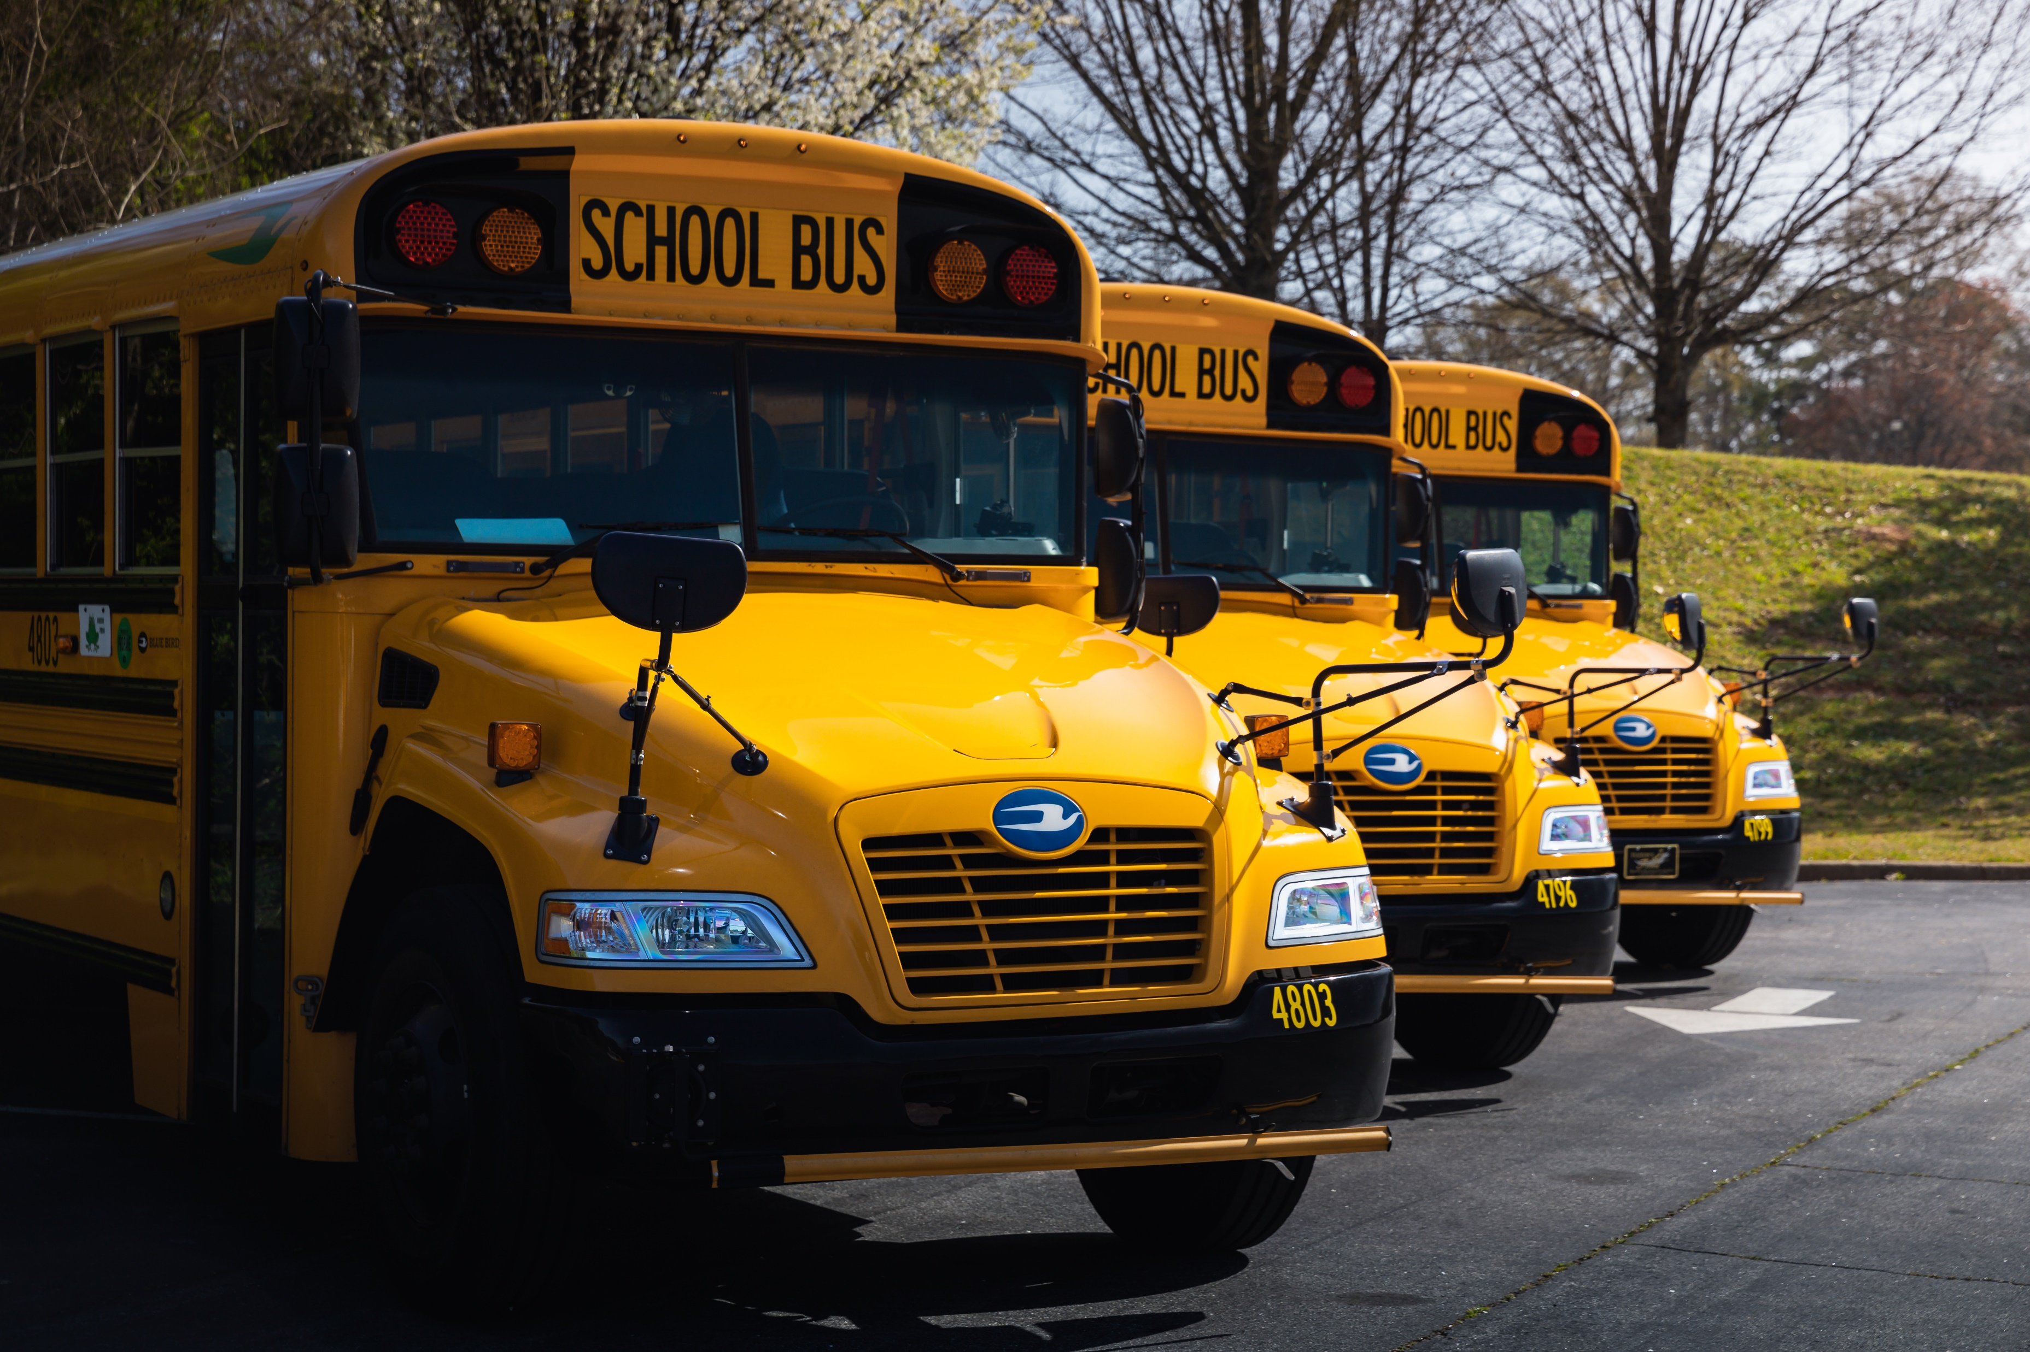
Before and After Analysis
Data Sources:
  School Bus Data Logger
  School Bus Fuel Logs
  School Bus Driver Interviews
Analysis Period:
  Before – One month (April 2022)
  After – One month (May 2022)
Analysis Metrics:
  Travel Time
  Average Speed
  Unscheduled Stops
  Fuel Consumption
  Emissions

Slide 5
Results

Slide 6
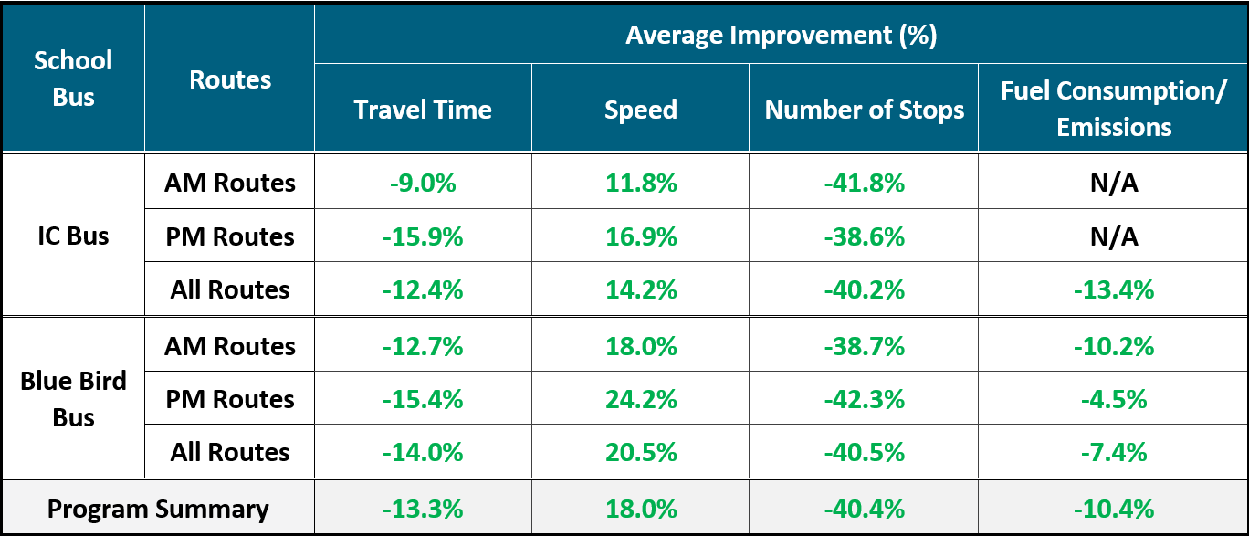
Before and After Analysis - Results

Slide 7
School Bus Driver Interviews
Drivers felt like they were able to more quickly progress through typically congested intersections
Bus drivers were more consistently on schedule and able to leave later and arrive earlier
Better on time performance led to less driver stress and more time to focus on student behavior and safe driving habits
The bus stopped less frequently which resulted in fewer opportunities for students to get up and/or participate in unsafe behaviors
Students were able to arrive at school on time and participate in school provided morning breakfasts

Slide 8
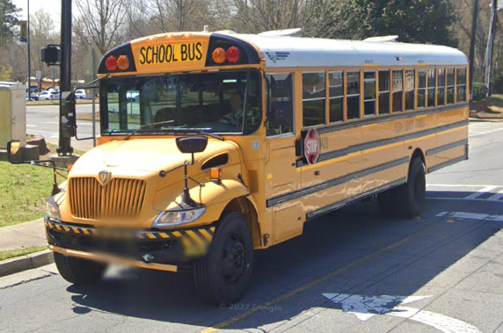
Conclusions
The School Bus Priority Pilot:
  Enhanced onboard safety of students and bus driver
  Improved route reliability and on-time performance
  Allowed more students to participate in breakfast program
  A reduction in fuel consumption and harmful emissions
Potential future benefits:
  Route optimization to help address bus driver shortage
  Significant reduction in fuel expenditures and bus maintenance costs

Slide 9
Questions?

